Slide 1

Covid-19 Visualizations and Machine Learning Prediction
Under the guidance of :
Dr. Uthama Kumar A
Yatin Kande
20BSR18040

Slide 2
ABSTRACT
To contain the spread of the COVID-19 pandemic, effective prediction, and forecasting are required. Data analysis and data visualization are discussed as solutions to these problems. Machine learning (ML) algorithms have shown promise in accurately predicting and forecasting COVID-19 spread. The presentation provides an overview of COVID-19, its transmission, and the available data sources. COVID-19 prediction and forecasting make use of a variety of ML techniques such as time series forecasting and Linear regression. Data quality, data scarcity, and model interoperable are among the challenges that ML faces in COVID-19 prediction. The potential impact of machine learning on COVID-19 prediction and forecasting is discussed, including improving prediction accuracy and insights on assisting or decision-making processes.

Slide 3
Introduction
The project is About The Analysis and Predictions of covid-19 diseases.
I have performed the analysis on “Jupyter Platform” and I have used tools like matplotlib, sklearn, and plotly.
Why to perform analysis and predictions?
First, it helps us understand the nature of the disease, its transmission, and its impact on individuals and society. By analyzing data on infection rates, hospitalizations, and mortality rates, we can identify patterns and trends that can inform public health policies and interventions.
Second, COVID-19 analysis can help us track the progression of the pandemic, detect emerging hotspots, and identify populations that are particularly vulnerable.
Third, COVID-19 analysis can help us evaluate the effectiveness of interventions, such as vaccination campaigns or social distancing measures, and make informed decisions about how to allocate resources. Overall, COVID-19 analysis is critical for mitigating the spread of the disease and reducing its impact on individuals and society.

Slide 4
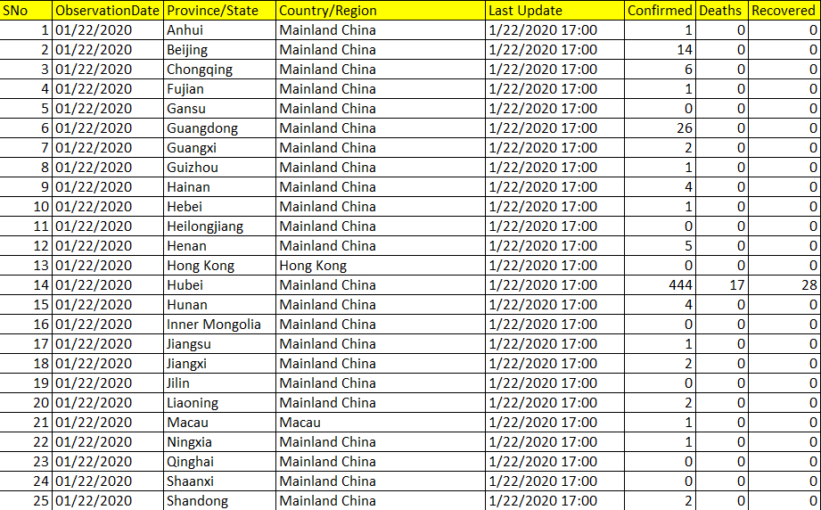
Dataset
Size – 3,06,500
Data from 1/22/2020 - 05/29/2021

Slide 5
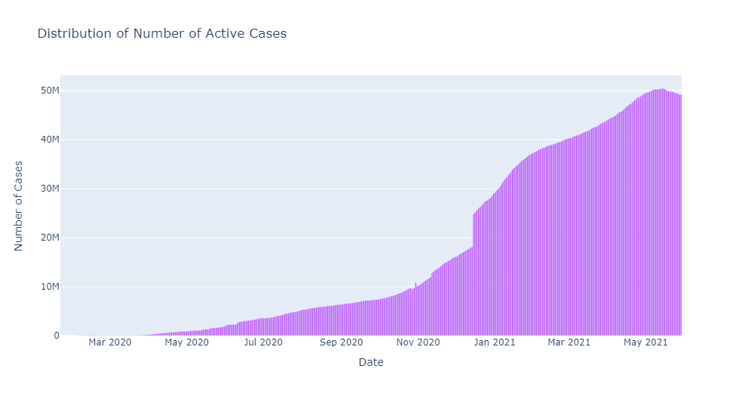
Distribution of the Number of Active cases
The formula to calculate active cases is:Active Cases = Number of Confirmed Cases - Number of Recovered Cases - Number of Death Cases.
If the number of active cases increases, it may indicate that the number of recovered cases or death cases is dropping in comparison to the number of confirmed cases.

Slide 6
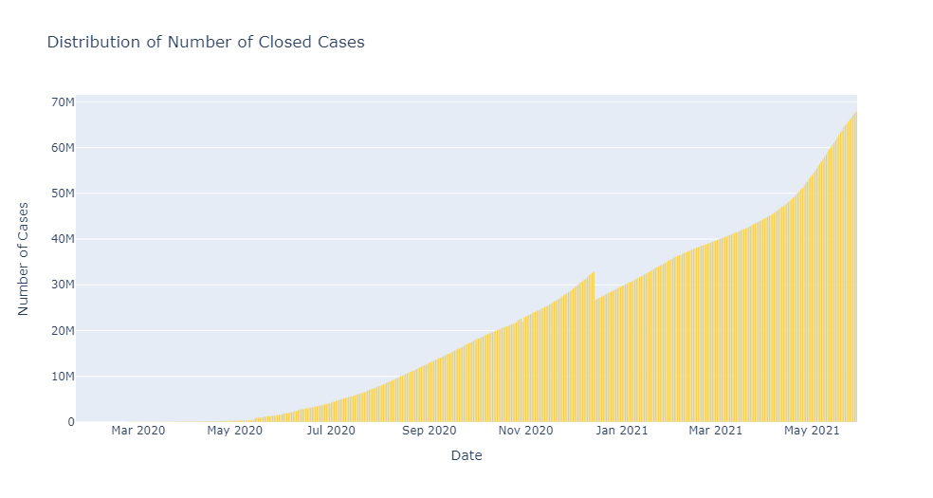
Distribution of Number of Closed cases
The equation "Closed Cases = Number of Recovered Cases + Number of Death Cases" is used to track the number of resolved cases of COVID-19.
An increase in the number of closed cases means that either more patients are recovering from the disease or more people are dying due to COVID-19.

Slide 7
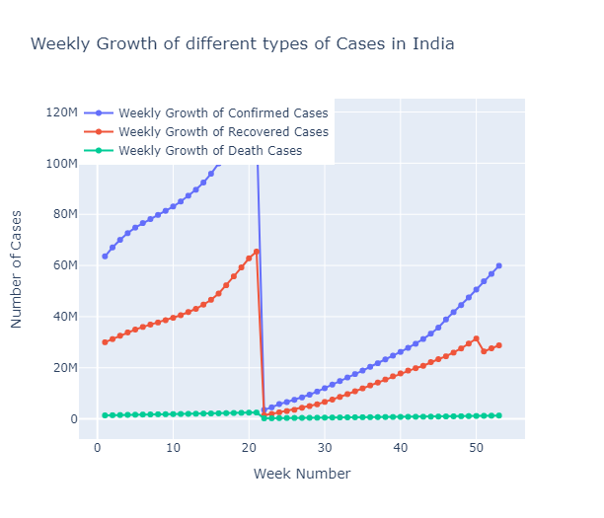
Weekly Growth of different types of Cases in India

Slide 8
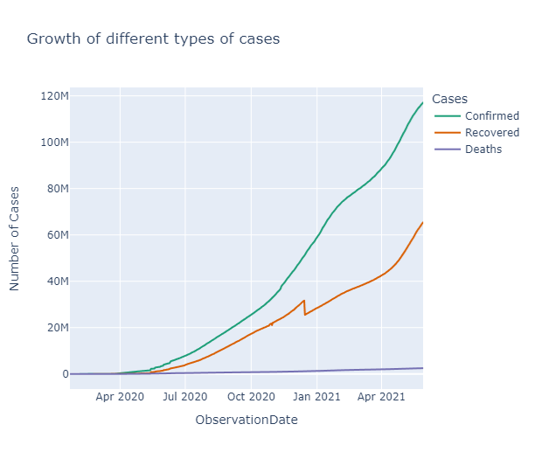
Growth of different types of cases

Slide 9
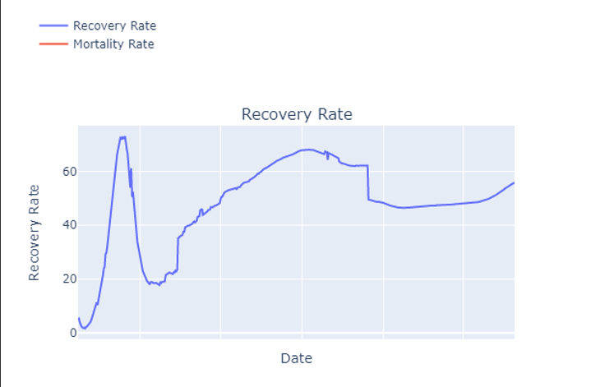
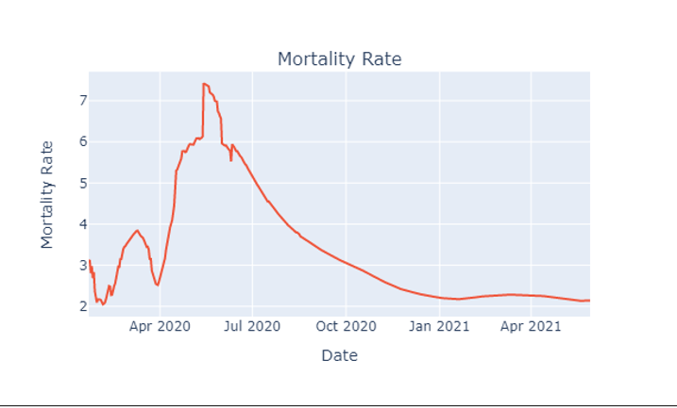
Recovery Rate and Mortality Rate
Recovery Rate= (Number of Recoverd Cases / Number of Confirmed Cases) x 100
Recovery rate has started to increase again, which is also a positive sign as it means more people are overcoming illnesses and returning to good health.
Mortality rate = (Number of Death Cases / Number of Confirmed Cases) x 100
Mortality rate has been consistently decreasing for a significant period of time, indicating a positive trend.

Slide 10
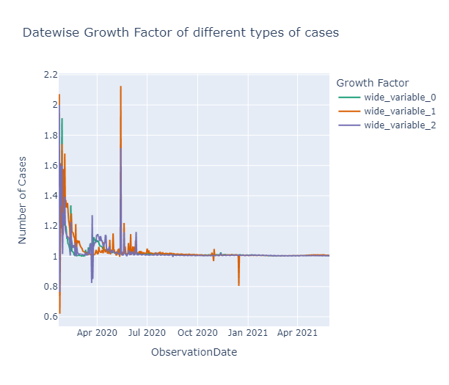
.
Growth factor is a measure of the rate at which the number of new confirmed cases, deaths, or recoveries is increasing or decreasing over time.
The formula for calculating the growth factor is to divide the number of new confirmed, recovered, or deaths for each day by the number for the previous day.
If the growth factor is less than 1, it indicates a decrease in the number of cases, while a growth factor greater than 1 indicates an increase in the number of cases. A growth factor of 1 means no change.

Slide 11
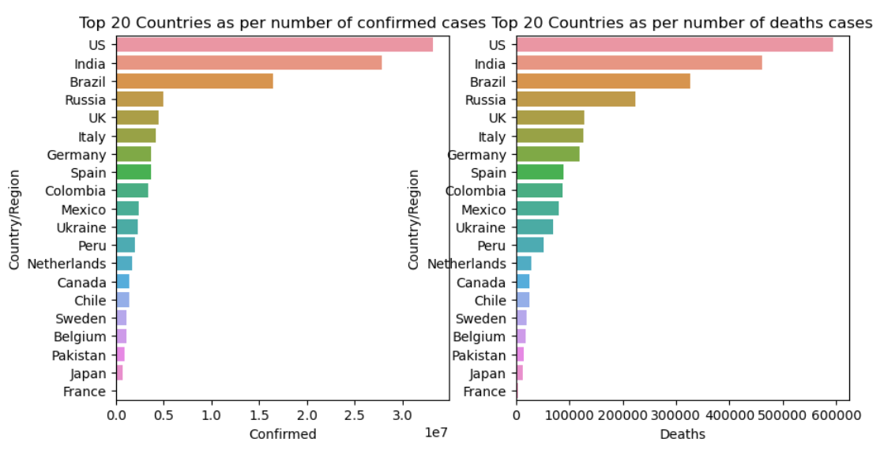
Top 20 Countries as per Confirmed and Death cases

Slide 12
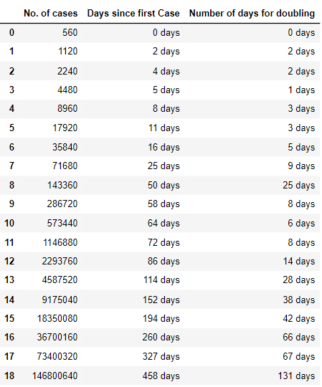
Rate of Doubling for confirmed around the world

Slide 13
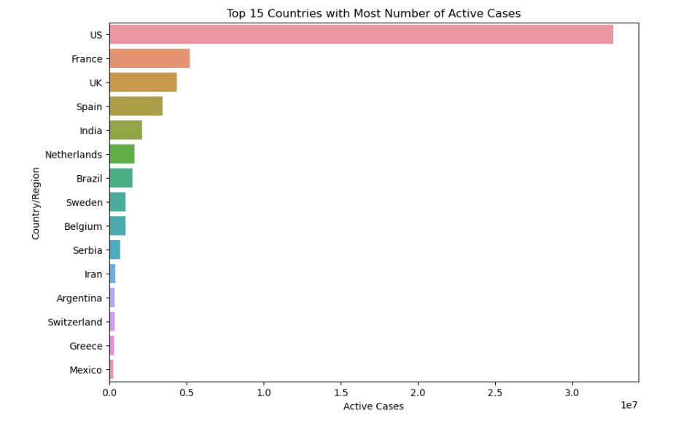
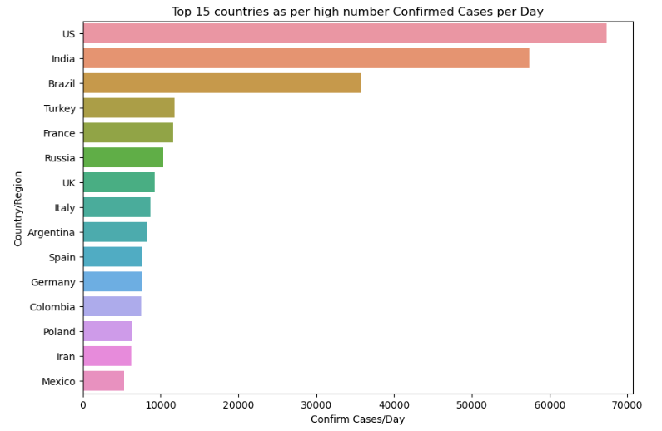
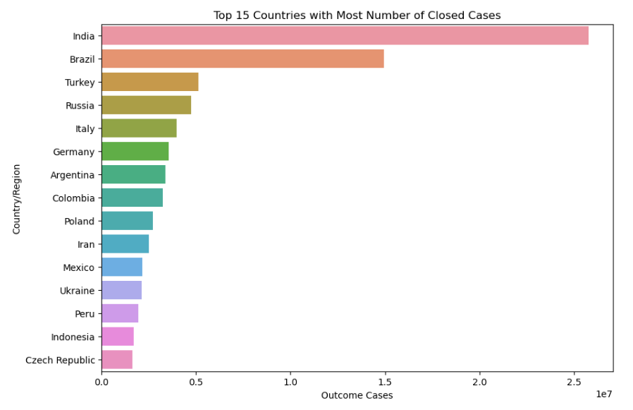
.

Slide 14
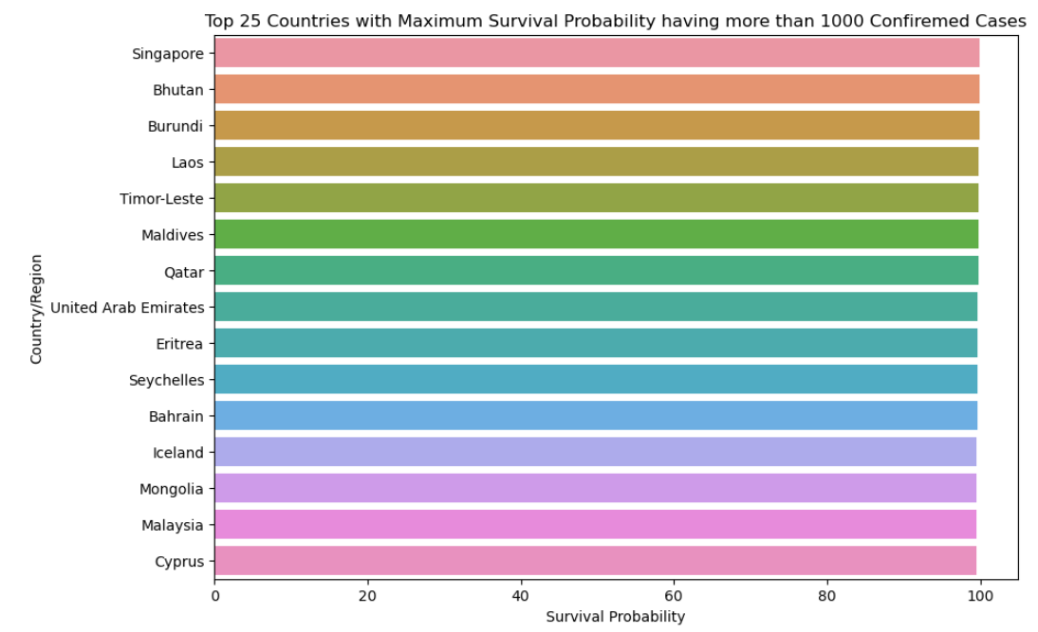
Top 25 countries with maximum survival probability having more than 1000 confirmed cases

Slide 15
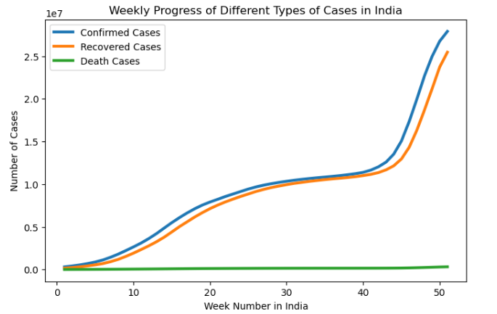
Weekly Progress of Different Types of Cases in India

Slide 16
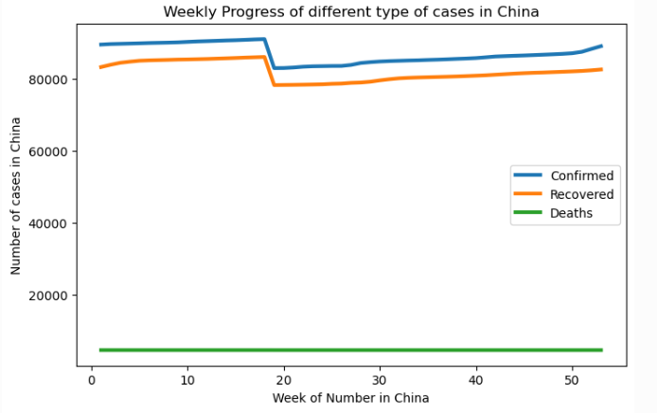
Weekly Progress of Different Types of Cases in China

Slide 17
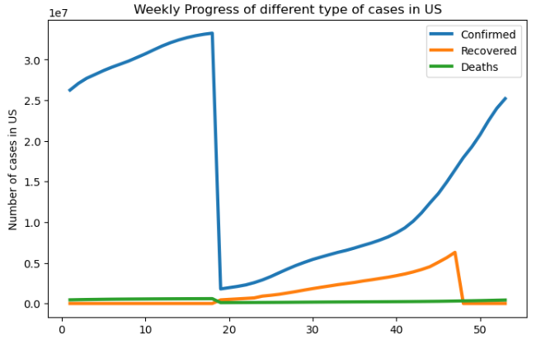
Weekly Progress of Different Types of Cases in US

Slide 18
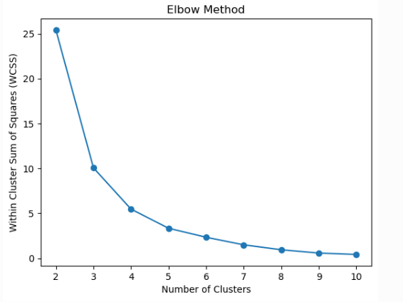
Elbow Method
The Elbow Method is then used to determine the optimal number of clusters to use for the K-Means clustering
I am plotting the K-Means clustering on the Mortality and Recovery rates of each cluster.

Slide 19
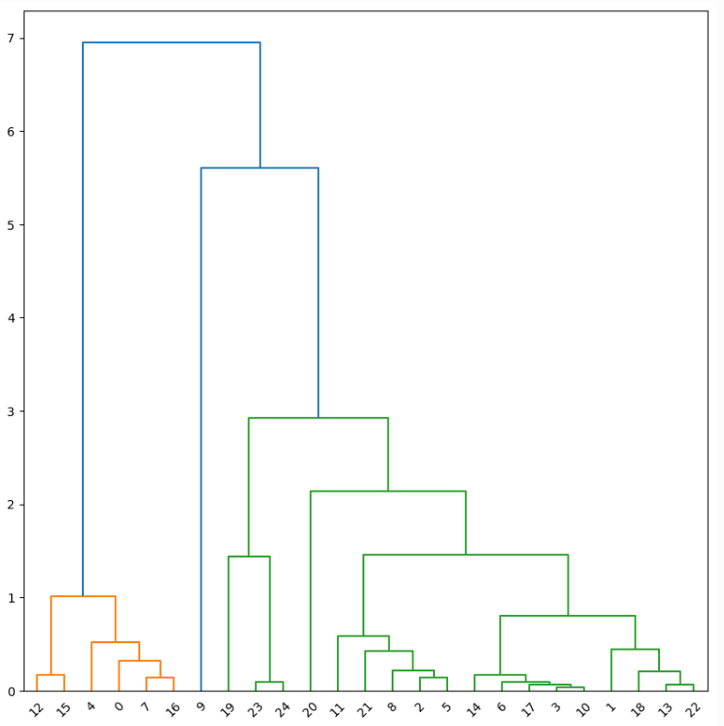
Dendogram
Dendrograms are used in hierarchical clustering, which is a type of unsupervised machine learning, to visualize the relationships among the clustered data points
It is used to identify groups of countries with similar COVID-19 patterns based on their mortality and recovery rates

Slide 20
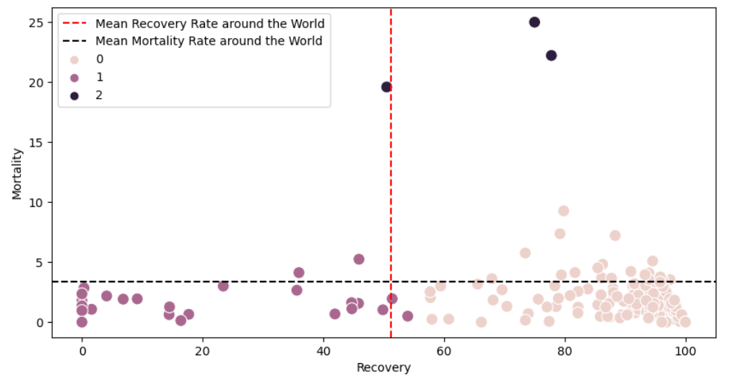
Cluster plot
Cluster 0: ['India', 'Brazil', 'Turkey', 'Russia', 'Italy', 'Argentina', 'Germany', 'Colombia', 'Iran', 'Poland’] (Low Mortality Rate and really High Recovery Rate)
Cluster 1: ['US', 'France', 'UK', 'Spain', 'Netherlands', 'Sweden', 'Belgium', 'Serbia', 'Switzerland', 'Greece’] (Low Mortality Rate and really Low Recovery Rate)
Cluster 2: ['Yemen', 'MS Zaandam', 'Vanuatu’] (High Mortality Rate and considerably Good Recovery Rate)

Slide 21
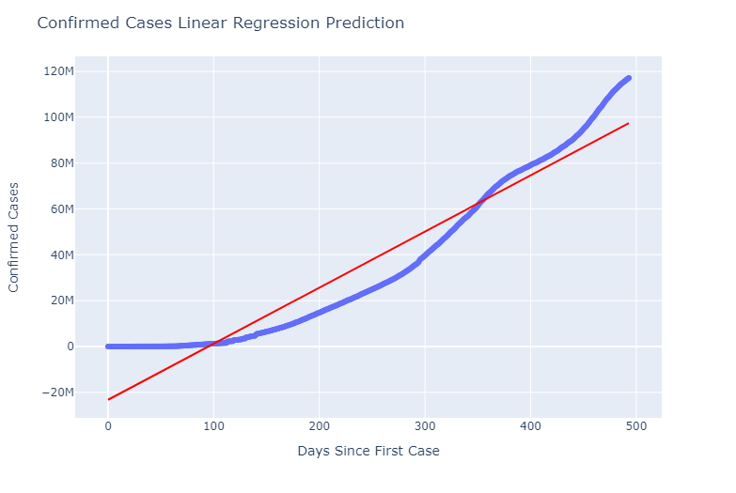
Linear Regression
The Linear Regression Model is absolutely falling apart. As it is clearly visible that the trend of Confirmed Cases is absolutely not Linear.

Slide 22
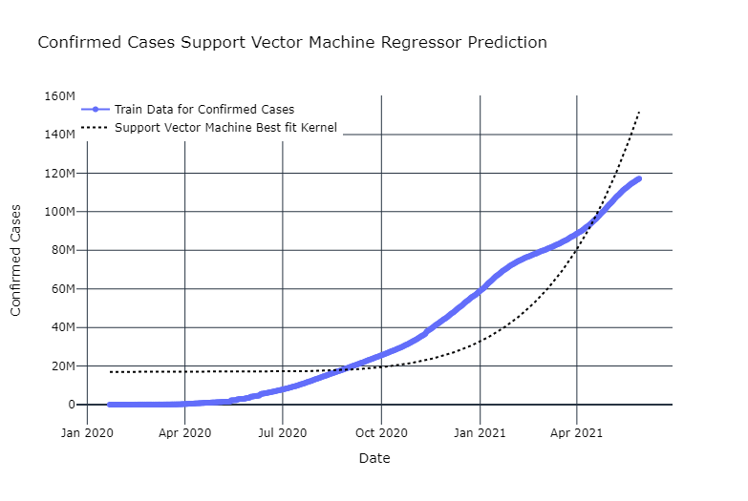
Support Vector Machine Regressor
The support Vector Machine model isn't providing great results now, the predictions are either overshooting or really lower than what's expected

Slide 23
Conclusion
What I have understood from the analysis is how confirmed, death and recovered cases have changed over the 1 year period of time.
It also gave me an analysis of Active and Closed cases
I could also perform a few machine learning algorithms but couldn’t get the best results from them.

